Slide 1
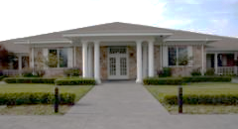
Fisher House Foundation
“Because a Family’s Love is
Good Medicine”
Notes:
See speaker notes on subsequent slides
12 Slides (including this intro slide - Personalize as required for speaker) + additional back-up slides you can mix into brief if required
(Slide date: Feb. 2017)

Slide 2
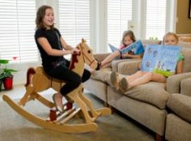
What is a Fisher House?
“Home away from home”
71 Fisher Houses currently located at military and VA medical centers
Within walking distance
8-21 suites, 5,000-16,800 sq ft
Common kitchen, dining room, laundry, living room & playroom
A home…not a hotel!
Notes:
So what is a Fisher House?
First and foremost – it is a HOME. Not just lodging, or temporary quarters, It is a home where families of Service Members and Veterans can stay while their loved one receives treatment.
There are 71 Fisher Houses located at across the country (including 2 in Germany, and 1 in Birmingham, United Kingdom) located at every major military and a number of large VA Medical Centers – usually within walking distance.
Our houses have from 8-21 beautifully furnished suites with up to 16,000 square feet of living space, complete with a common kitchen, dining room, laundry, living room, playroom.
Our founder, Zachary Fisher, wanted our guests to feel like they were staying in HIS home – and he wanted to show them how much our nation appreciates their sacrifices on our behalf.

Slide 3
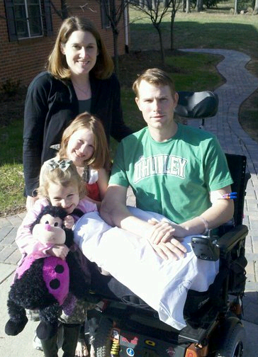
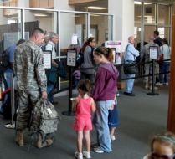
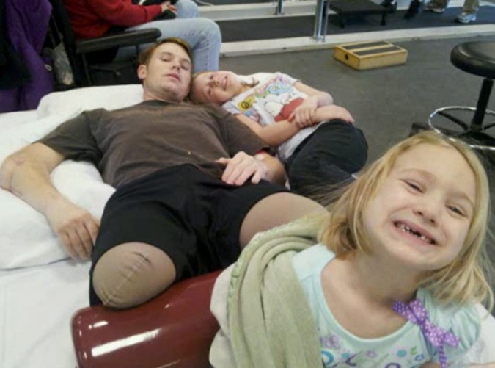
Notes:
To give you just one of thousands of stories, let me tell you about the Allen Family:
In January of 2011, Staff Sergeant Chaz Allen was seriously injured when he stepped on an IED, losing both legs and breaking his elbow.
Chaz was flown to the Walter Reed Army Medical Center in Washington DC for treatment.
His wife Jessica and their two small girls lived in Tennessee. Jessica wanted to be by her husband’s side while he faced months of medical treatment and rehabilitation, while at the same time maintaining a sense of normalcy for their children.
The couple had worked out a plan where Jessica would travel back and forth, taking care of their girls in Tennessee for one week, and then flying back to Chaz in Washington, CD for another week. They planned to use their life savings to fund this travel.
Through the grace of donations from the American Public, Jessica and her daughters were able to instead stay at the Walter Reed Army Medical Center Fisher House. Hero Miles arranged for Jessica to fly back and forth to DC free of charge for the duration of Chaz’s medical treatment.

Slide 4
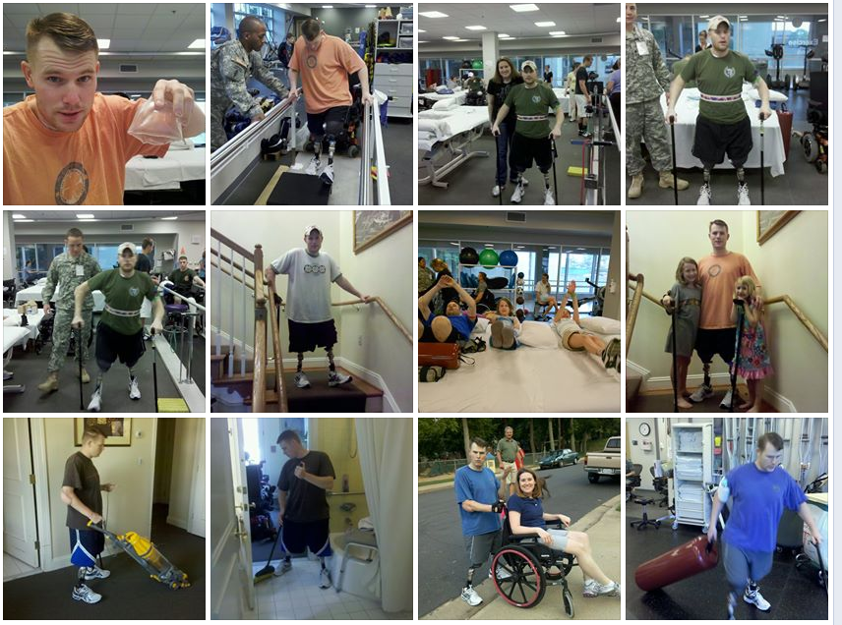
Notes:
After several months, Jessica and her daughters were able to witness Chaz take his first steps on his new prosthetic legs.
Jessica Allen gave us these pictures from the “Team Allen” Facebook page.
These are shots of Chaz during his recovery.
In the middle slides, you can see Chaz on his first set legs (smaller than those who uses now) inside the Fisher House.
You can see daughters (Deryn and Ryann) doing therapy with him at Walter Reed, and you can also see them on the stairs with him in side the Fisher House.

Slide 5
About the (Your Home) Fisher House

Slide 6
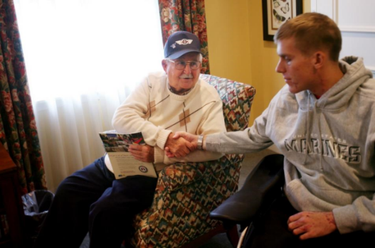
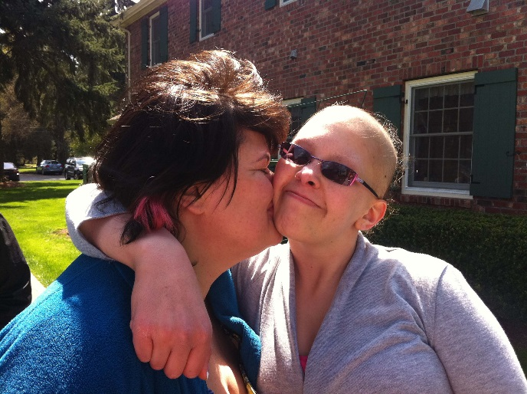
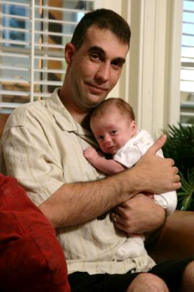
Serving the families of…
…Veterans, Active Duty, and Dependents
…Wounded, Injured, and Ill
Notes:
Fisher Houses serve the 90 year old WWII veteran, as well as the 19 year old Afghanistan veteran…
…as well as the 9-day old dependent of a military family staying in an neo-natal intensive care unit.
Many people only associate us with wounded warriors. We do help them, but that is a small subset of who we serve. (….Cancer, cardiac, car crashes, etc., happen to service members every day)
In actuality, if you have a parent who was a Veteran
…or a spouse
…or a son or daughter who is currently serving
…or if you yourself are a Veteran, then these houses are for YOU and YOUR LOVED ONES

Slide 7
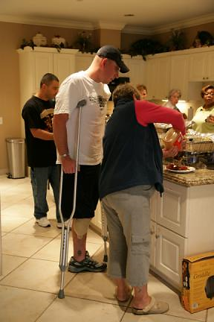
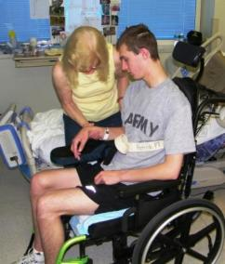
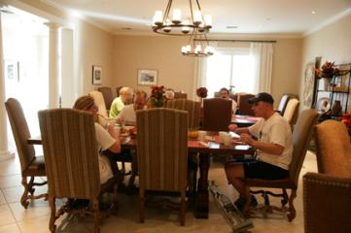
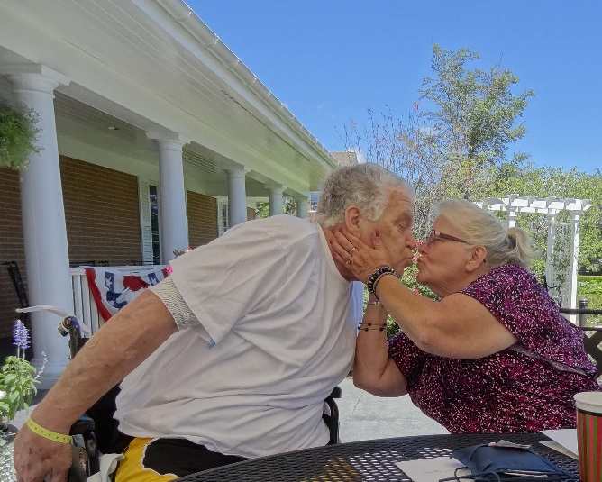
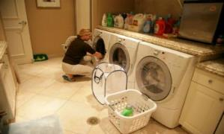
Notes:
If you have experienced a loved one in the hospital for an extended period of time, you know it is not unusual for family members to spend the entire day – and most of the night - at their loved one’s bedside.
After a long day at the hospital, it is nice to have a place to come back to, where you can prepare a home cooked meal, change clothes, rest…and perhaps comfort –or be comforted by - other families who are experiencing similar challenges.
Our motto is, “A family’s love is the best medicine.” A Fisher House provides a loving environment that helps fills that prescription.

Slide 8
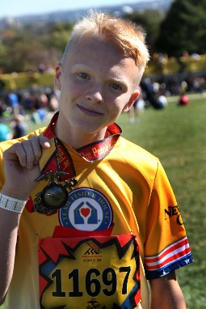
More than 66,000
tickets to service
members & families
More than $5.5 million raised since inception (2006)
More than 700 scholarships totaling $1.4 million
Since inception 10,000+ free nights
Notes:
While our primary mission will always be to build new Fisher Houses where needed most, we do have some other key efforts that support military families.
Our Hero Miles program provides round-trip airline tickets to wounded, injured and ill service members and/or their families who are undergoing treatment at military or VA medical centers; or who are attending an authorized event. To date, we have provided nearly 66,000 tickets, a savings worth more than $100 million.
A similar program is Hotels for Heroes. People can donate their hotel reward points to Fisher House, and we can provide hotel rooms when our Fisher Houses are full, or a service member is receiving critical care at a location where we do not have a Fisher House.
Team Fisher House is the online, grassroots fundraising program of Fisher House Foundation. With this program, we provide a medium for individuals to raise funds through events like the Marine Corps Marathon, NYC Half Marathon, the Army 10 Miler - as well as community events and races. Last year alone, runners, cyclists, swimmers, etc. raised over $1M.
Remember that wounded warrior we talked about in the beginning of this presentation? Bottom right photo is Chaz Allen competing in the Army Ten-Miler for Team Fisher House.

Slide 9
Fisher House Facts
Since 1990
Served over 305,000 families
Over 8000 families of combat casualties
Provided over 7 million nights of lodging
Saved families more than $360 million
71 houses
At the (Your Home)House
Notes:
Since 1990
Served over 305,000 families
Over 8000 families of combat casualties
Provided over 7 million nights of lodging
Saved families more than $360,000,000
71 houses
On any given night we can lodge 950 families…and that number grows with every new house!

Slide 10
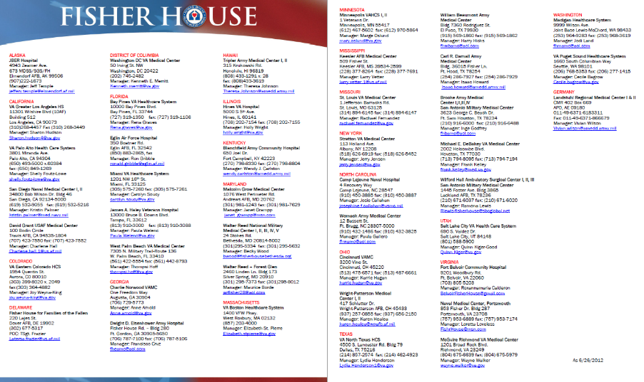
Where Do We Have Fisher Houses?
Available at www.fisherhouse.org
Notes:
Our Website is easy to remember: fisherhouse.org
Feel free to give this Website out to anyone interested in any of our programs. Everything I’ve told you and much, much more are on the site, including contact information for all our Fisher Houses.

Slide 11
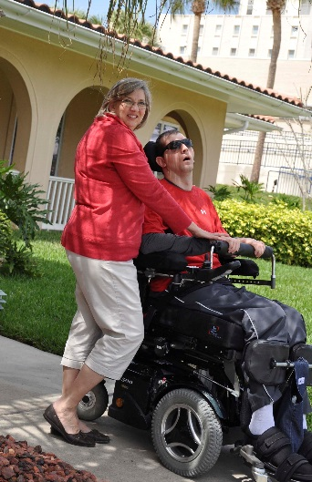
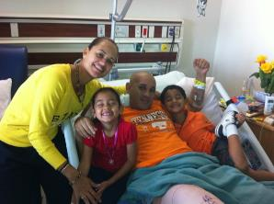
The Mission Continues
23 Million Veterans
Over 150 major VA medical centers
Right now we are only at 24 VA locations
Today’s Wounded Warriors will need a lifetime of care
Migrate from Military to VA health care
Long term caregiver support
>10,000 care givers today and growing
>20% of Hero Miles support
End of combat operations doesn’t stop
Cancer
Car Accidents
Cardiac Arrest
Training Accidents
Notes:
Emphasize that as the wars draw down, it does not mean there is no longer a need for support.
VA and DoD research shows that many mental health issues and even physical ones do not show up for years after the person is off active duty.
Furthermore, those who were wounded will often need care the rest of their lives.

Slide 12
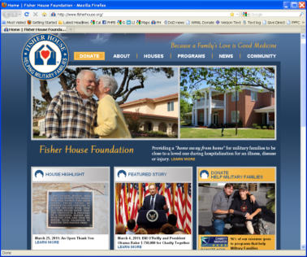
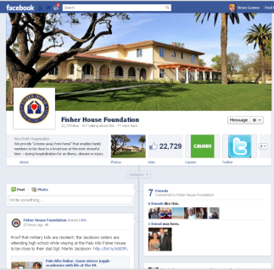
Learn More About Fisher House…
WWW.FISHERHOUSE.ORG
“Like” us on acebook
We’re also on YouTube, Twitter, Flickr and Pinterest!
Notes:
Last Slide –
Thanks for your attention.
We are running out of time, but I strongly encourage you to visit our website at Fisherhouse.org (note: “.org….NOT .com!”) to learn more about what we do.
Our website provides locations and contact information for every fisher house, as well as detailed information about all our programs, news articles, current events, videos, pictures, testimonials and ideas on how you can help.
We are also on Facebook, YouTube, Twitter, Flickr, & Pinterest (…If you don’t know what those are – ask your kids!!)
….and for those of you who work for the Federal Government, our CFC designation code is #11453!
Thanks for your attention – I am happy to answer any questions.

