Slide 1
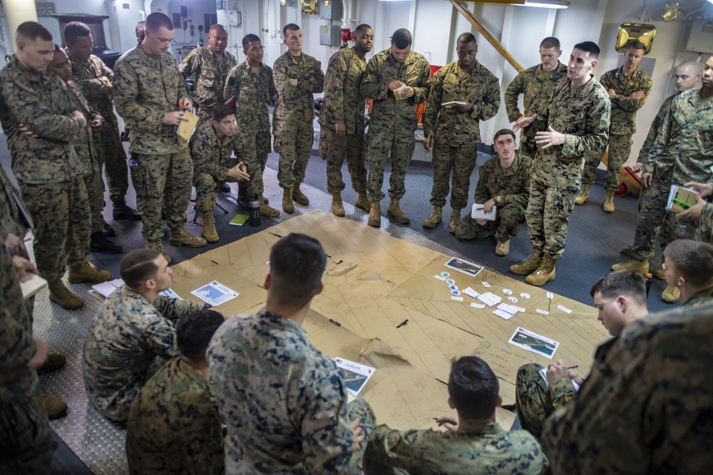
FOFH
Group Exercise

Slide 2
FOFH Board Exercise
#1
Draft a perfect board:
How big would it be?
How often would you meet?
Who would you want? What officers?
#2
What subcommittees would you want for your board and why?
What specific tasks?
#3
What commitment would someone have to make to be on your board?
Notes:
Group Exercise – 6 tables in room.
Pick two tables to answer #1
Pick two tables to answer #2
Pick two tables to answer #2
10-15 minutes…..Write on Butcher Block sheets Each table present their results to crowd
Pick a spokesman to present
Entire Room Discuss

Slide 3
FOFH Board Exercise – Attendees’ Answers
Answer 1: The Perfect Board
Membership
10-20 members, depending on location and program
Matrix of expertise (IT, legal, marketing, grant-writing, CPA, community leaders and professionals, etc)
How often should they meet?
Quarterly or more; monthly during capital phase
Virtual meetings (e-mails)
Officers
President, Treasurer, Secretary, Secretary, Advancement
Consider a VP or second for these officers when they must leave the board unexpectedly
#1
Draft a perfect board:
How big would it be?
How often would you meet?
Who would you want? What officers?
Notes:
2 tables – question 1
2 tables question 2
3 Tables question 3
10-15 minutes…..Write on Butcher Block sheets each table present.
Neat handwriting
Pick a spokesman
Discuss

Slide 4
FOFH Board Exercise – Attendees’ Answers
How big would your board be?
Somewhere between 10-20 members
Big enough to meet the task and represent in the community
Active participation required
Raising capital
#1
Draft a perfect board:
How big would it be?
How often would you meet?
Who would you want? What officers?
Notes:
2 tables – question 1
2 tables question 2
3 Tables question 3
10-15 minutes…..Write on Butcher Block sheets each table present.
Neat handwriting
Pick a spokesman
Discuss

Slide 5
FOFH Board Exercise – Attendees’ Answers
How often should the board meet?
Monthly for capital capacity
Quarterly for on going
Face-to-face is important
Emails often (don’t forget to respond to emails!)
#1
Draft a perfect board:
How big would it be?
How often would you meet?
Who would you want? What officers?
Notes:
2 tables – question 1
2 tables question 2
3 Tables question 3
10-15 minutes…..Write on Butcher Block sheets each table present.
Neat handwriting
Pick a spokesman
Discuss

Slide 6
FOFH Board Exercise – Attendees’ Answers
Number of Officers, and what are the roles they need to fill?
President/CO
Vice President
Treasurer + Asst Treasurer
* Secretary = Asst Secretary
Diversity of skill sets:
Media/Marketing
CPA
Grant writing
IT
Business savvy professionals
Fundraising Capacity
Geographic representation
Representation of local industries
#1
Draft a perfect board:
How big would it be?
How often would you meet?
Who would you want? What officers?
Notes:
2 tables – question 1
2 tables question 2
3 Tables question 3
10-15 minutes…..Write on Butcher Block sheets each table present.
Neat handwriting
Pick a spokesman
Discuss

Slide 7
FOFH Board Exercise – Attendees’ Answers
#2
What subcommittees would you want for your board and why?
What specific tasks?
Question 2: Subcommittees
Development
Fundraising, donor retention/recognition, strategic planning and major gift prospecting
Marketing & Outreach
Community growth, staffing 3rd party events, planning/hosting FOFH events, media, social media, VA/DoD liaison
Finance
Budget, audit, payroll
Investments, endowment management
HR and Nominations
Recruiting/hiring staff, recruiting Board Members, employee policies
Governance
Policies and procedures, annual compliance, bylaws
Notes:
Group Exercise – 6 tables in room.
Pick two tables to answer #1
Pick two tables to answer #2
Pick two tables to answer #2
10-15 minutes…..Write on Butcher Block sheets Each table present their results to crowd
Pick a spokesman to present
Entire Room Discuss

Slide 8
FOFH Board Exercise – Group Answers
Question 3: Board Member Commitment
Time, talent, and/or treasure
Passion for and faith in the mission
Network
Personal financial commitment
Communication skills
Team player, selfless
Diversity
#3
What commitment would someone have to make to be on your board?
Notes:
Group Exercise – 6 tables in room.
Pick two tables to answer #1
Pick two tables to answer #2
Pick two tables to answer #2
10-15 minutes…..Write on Butcher Block sheets Each table present their results to crowd
Pick a spokesman to present
Entire Room Discuss

Slide 9
FOFH Board Exercise – Attendees’ Answers
Question 3: Board Member Commitment
Goal oriented/Committed to action
Faith and focus on mission
Selflessness/humble
Team player
Communication skills
Have a network – connections/influencer?
Research
Financial commitment
Time
Facetime
Show up at the house
Follow up
Communicate
Involvement/volunteer
Passionate for the cause
Take on roles
Collaborate
Time between meetings – leg-work
Step out of comfort zone
Take action/initiate
Diversity – personal and community
#3
What commitment would someone have to make to be on your board?
Notes:
Group Exercise – 6 tables in room.
Pick two tables to answer #1
Pick two tables to answer #2
Pick two tables to answer #2
10-15 minutes…..Write on Butcher Block sheets Each table present their results to crowd
Pick a spokesman to present
Entire Room Discuss

