Slide 1
Kitchen Refurbishment West Palm Beach Fisher House
Shelley Prickett
Fisher House Manager
West Palm Beach VAMC
Department of Veterans Affairs

Slide 2
Refurbishment Process for 501C3
Obtain proposal/quotes for project.
Select contractor.
Have selected contractor complete a SOW (Statement of Work) and drawings for the project. Must also submit a design package to show materials being used for interior design approval.
Meet with facility engineer, planning engineer, and interior designer.
Complete letter of intent – Donation letter to facility Voluntary Service.
Send with proposal (quote), SOW and drawings with letter of intent.

Slide 3
Refurbishment Process for VA FH Manager
Provide 501C3 with input for desired materials and layout.
Submit plans, SOW, design materials to Jennifer Koget, National Program Manager for concurrence and forwarding to FHF. Approval needed from FHF prior to submission.
Submit group intent letter, SOW, project drawings, design package and FHF/Jennifer Koget concurrence to Voluntary Service.
Compose memo on behalf of Voluntary Service Chief. This just helps the process along quicker. Be prepared to make changes per the Voluntary Chief.
Track progress of the paperwork through the VA process – FACILITY to VISN to UNDER SECTRETARY FOR HEALTH (Central Office). Keep group informed of the progress. VISN submits package via e-mail to vhagpfreviewteam@va.gov. Be sure to cc: Jennifer Koget and Director of Voluntary Service Office on memo and e-mail.

Slide 4
Refurbishment Process for the Manager - continued
If FH is to be closed during the project, manager to do the following:
1) Hotel contract using GPF – submit to Contracting for procurement
2) Area where the project will be taking place – clear area – Where do you store everything? Moving and storage company vs. keeping at Fisher House in a room?
3) Order new appliances, furniture, etc using GPF/Refurbishment funds.
4) Have fire alarm system taken off line during demolition.

Slide 5
Refurbishment Process for Manager - continued
If FH is to be closed during the project, manager to do the following:
5) Keep Jennifer Koget (who will keep FHF updated) and group informed of progress via pictures and e-mail updates and proposed timeline.
6) Keep facility leadership up-to-date regarding progress and proposed timeline.
7) Schedule post project completion cleaning with facility EMS (housekeeping).
8) Schedule post renovation carpet/tile and window cleaning

Slide 6
Lessons Learned- FH Manager Perspective
Process for gift approval – Mixed instructions
Regardless of age of building, VA Regs require all construction projects have pre-renovation asbestos survey – takes about 2 weeks to obtain. - This held up the demolition and start of the project.

Slide 7
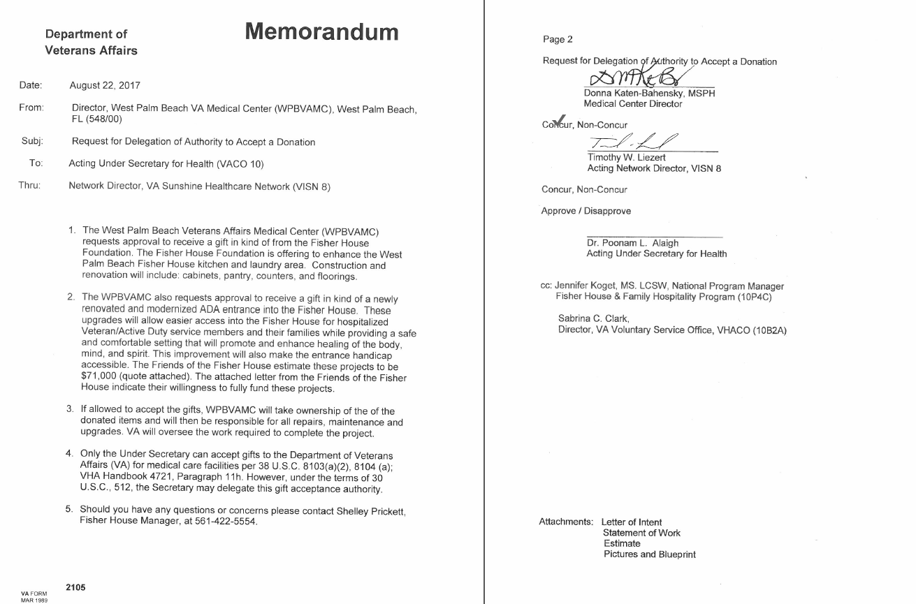
MOA between FOFH & VA

Slide 11
Friends of Fisher House West Palm Beach Support
New kitchen, plus…
Credit card for Manager to purchase approved items
E-mail sent to president prior to purchase except purchase of weekly groceries
Weekly grocery shopping – Spend around $300-$400 weekly
Shirts for the housekeeper with the FH logo – Purchased semi-annually
Magazine and newspaper subscriptions for the Fisher House
WIFI – prior to activation to the VA WIFI network
Hotel stays – when I cannot get rooms in the community at the hotels I have an agreement
Annual Community, Volunteer and Veteran Service Organization Open House
Holiday dinners – catered or purchase food
Organizing and partaking in community service outreach events for the Fisher House – donations and awareness

Slide 12
Questions?
Thank you!

